Slide 1
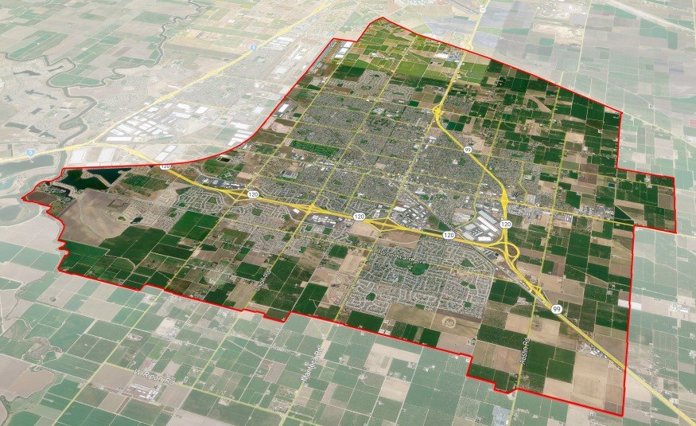
PLANNING COMMISSION
101

Slide 2
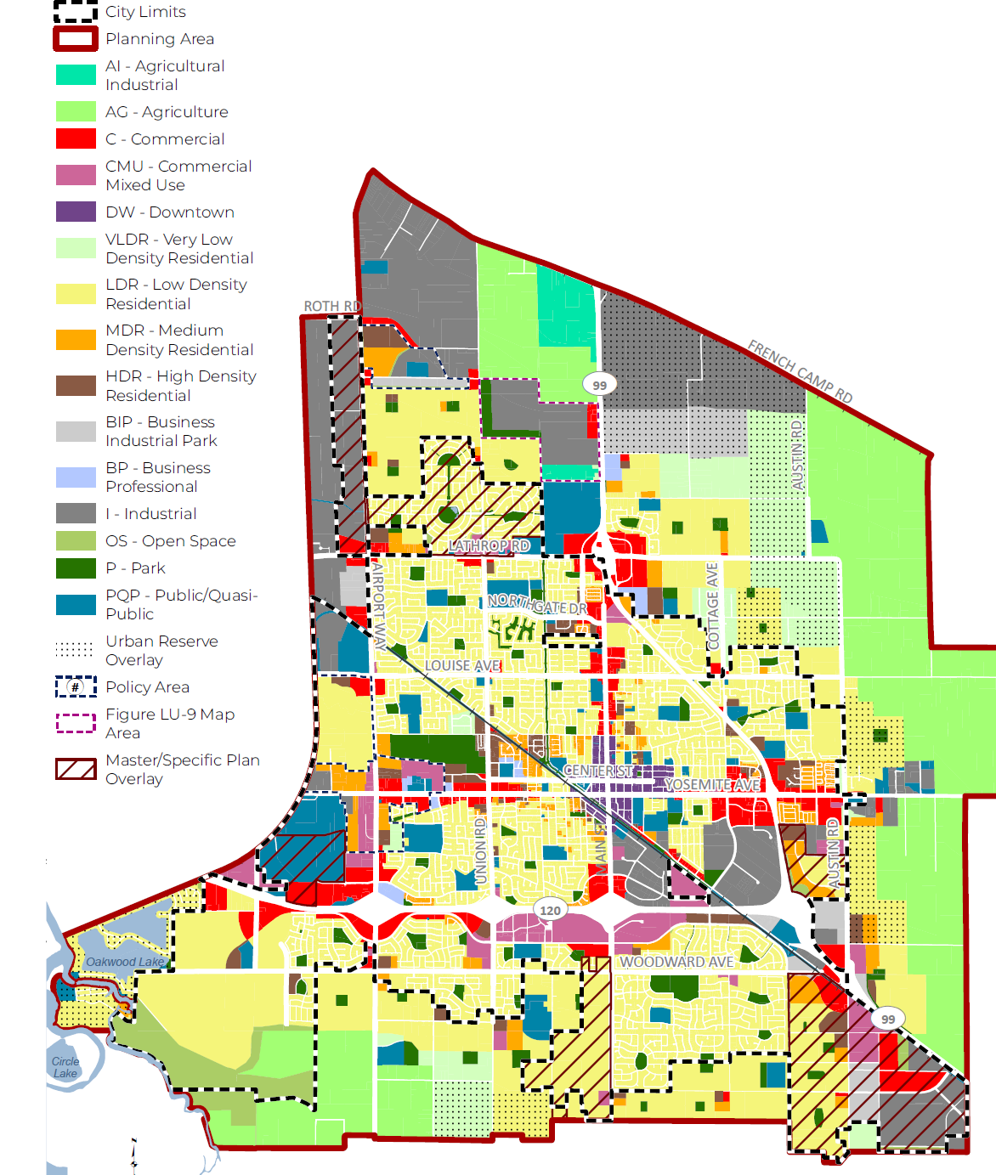
WELCOME
City Staff
Planning Commission Overview
Enacting Policies, Rules. Regulations
Planning Review Process
Planning Entitlements & Permits
Conditional Use Permits v Site Plans
Land Division
California Environmental Quality Act
Principal Role & Responsibility

Slide 3
CITY STAFF
Brad Wungluck | Interim Director of Development Services: Development Services Administrator
Jesus R. Orozco | Deputy Director of Development Services: Planning Division & Planning Commission Manager
Kristy Smith| Administrative Assistant III: Planning Commission Secretary
Daniella Green | Assistant City Attorney: Planning Commission Legal Counsel
Michael Selling | Deputy City Engineer: Technical Support Staff
Toben Barnum | Associate Planner: Technical Support Staff
Sol Jobrack | Associate Planner: Technical Support Staff
Allison Diaz | Assistant Planner: Technical Support Staff
Nzuzi Mahungu | Assistant Planner: Technical Support Staff
* Police/Fire/Public Works representatives as needed

Slide 4
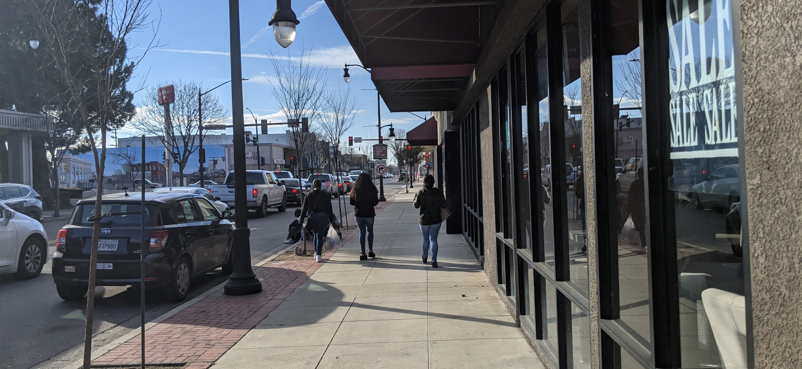
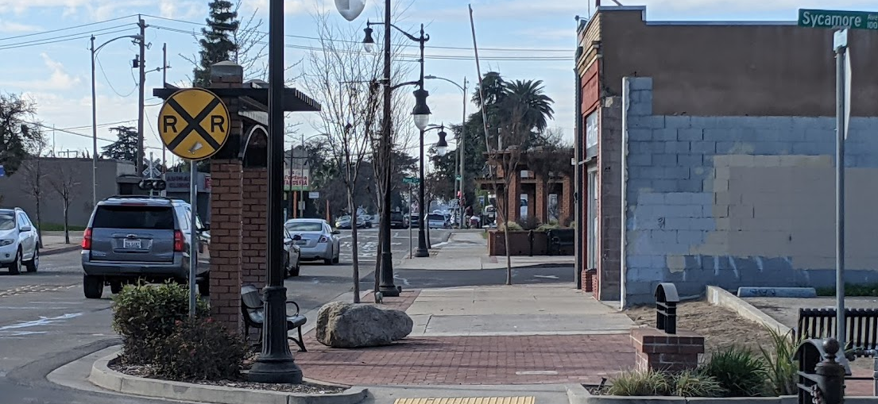
Planning Commission Overview
Planning Commission Roles & Duties
  Serve as an advisory board to the City Council
  Serve as the official Planning Agency as required by Land Use & Planning Law
  Review and consider discretionary development applications
  Act as an appeal board for administrative permits
  Participate in Commissioner trainings & workshops
Meetings
  Attendance
  Regular Meetings
  Special Meetings
  Agenda Packet Distribution
  Pre-planning meetings
Ethics/Legal Responsibility
  Be impartial and vote in the best interest of the City
  Disclosure of ex-parte
  Recusals due to conflict of interests
Notes:
Section 17.02.030 - It shall be unlawful and a violation of the Manteca Municipal Code for any person to establish, construct, reconstruct, alter, or replace any use of land or structure, except in compliance with the requirements of this Title.

Slide 5
Enacting Policies, Rules, Regulations
2043 General Plan
Housing Element
Specific/ Master Plans
Manteca Municipal Code
Title 16: Subdivision Ordinance
Title 17: Zoning Code
Other Guiding Documents
Climate Action Plan
Design Guidelines
Council Policies

Slide 6






Planning Review Process
Application Review & Determination of Completeness
Project Distribution: City Dept. & Outside Agencies
Resubmittal & Correction
Noticing & Staff Report Preparation
Planning Commission Public Hearing

Slide 7
Planning Entitlements & Permits
General Plan Amendments x
Annexations x
Pre-zone/Rezone/ Ordinances x
Specific / Master Plans x
Development Agreements x
Tentative Subdivision Maps x
Planned Development Plans x
Conditional Use Permit x
Variance x
Site Plan & Design Review Permits x
PC Approval | PC Recommendation

Slide 8

Planning Entitlements & Permits Cont.
Noticing Requirements
  500-foot radius
  Newspaper
Staff Report, Findings, & Conditions of Approval
Public Hearings
  Planning Commission
  City Council

Slide 9
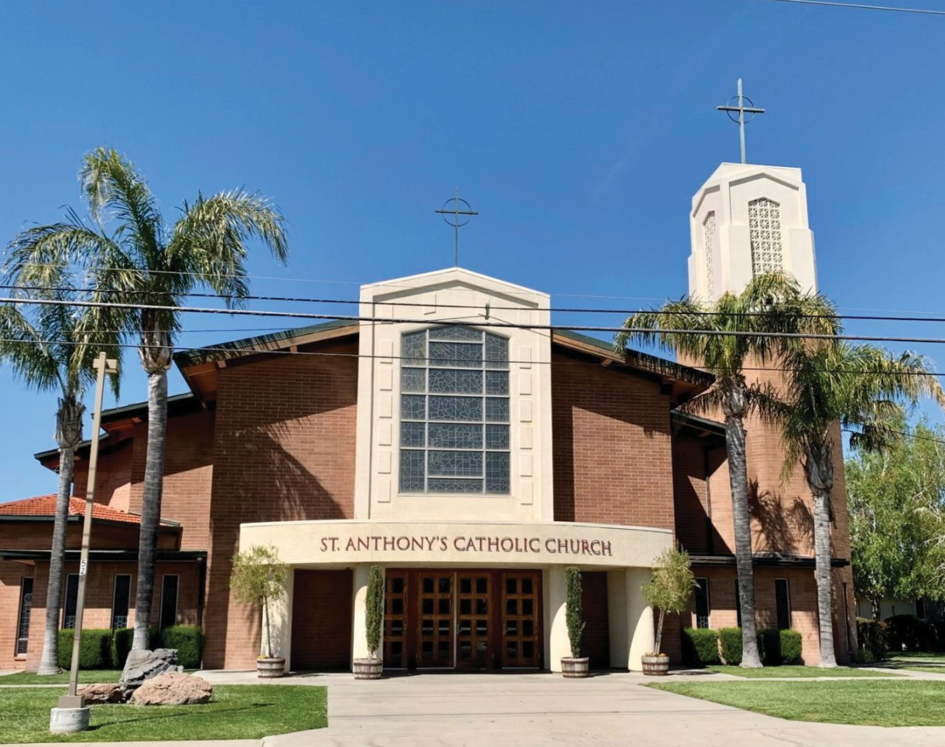
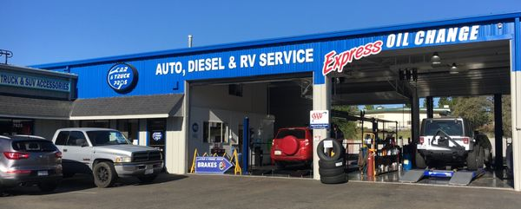
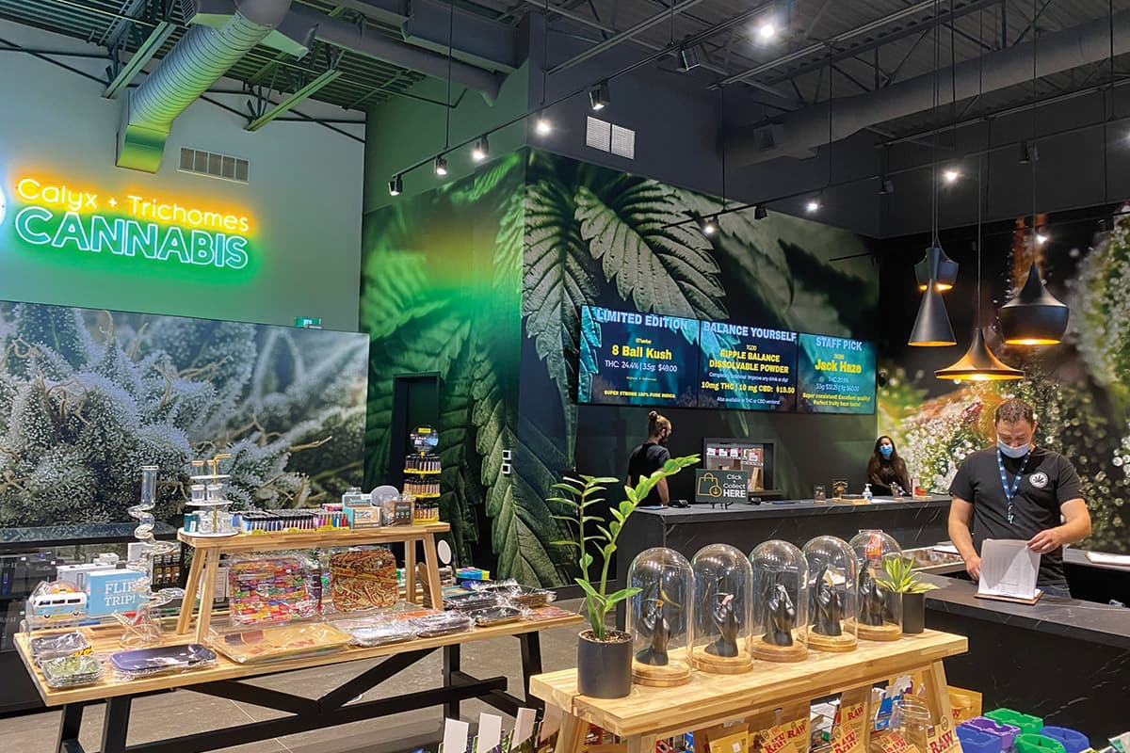
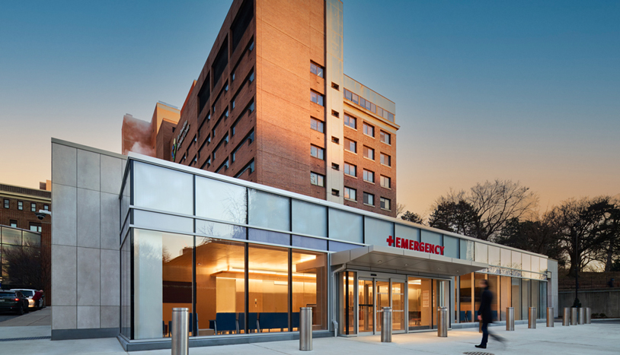
Use Permit v Site Plan
Conditional Use Permits
  Assesses a use’s compatibility with its surrounding environment due to the general operating nature of the use.
    Hours of operation
    Number of employees/patrons
    Traffic
    Noise/order/vibration
    Solid waste
    Dangerous/hazardous manufacturing or storage of material
    Other elements of a use

Slide 10
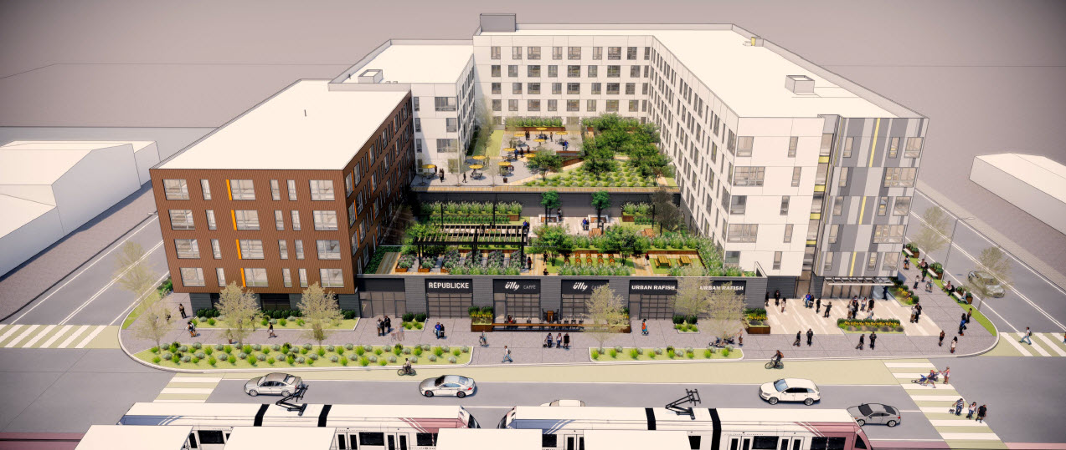
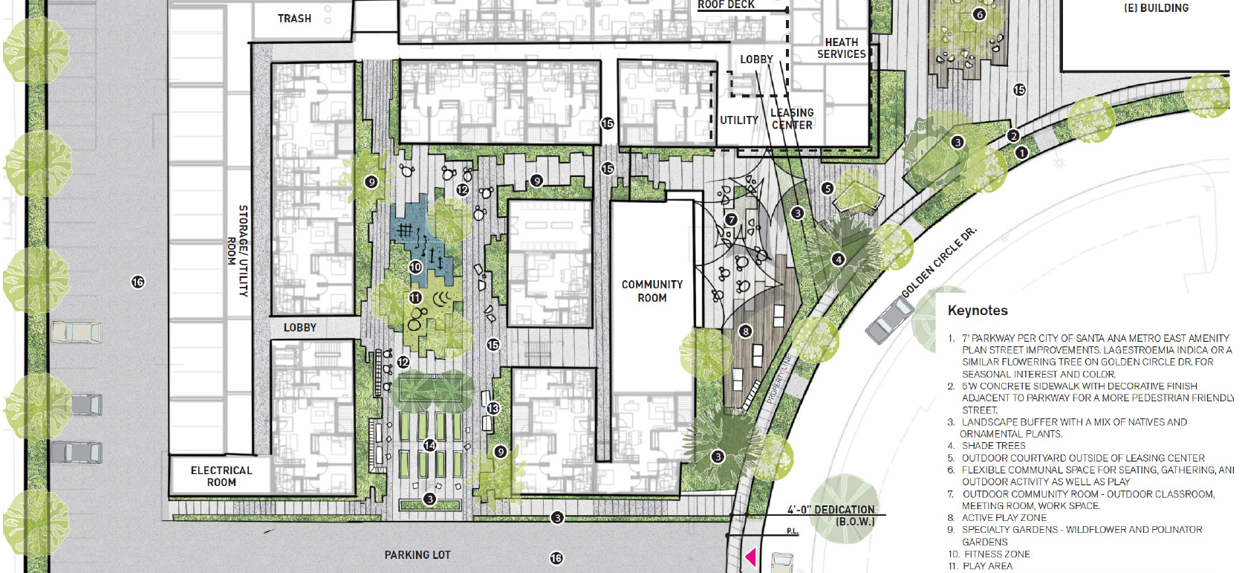
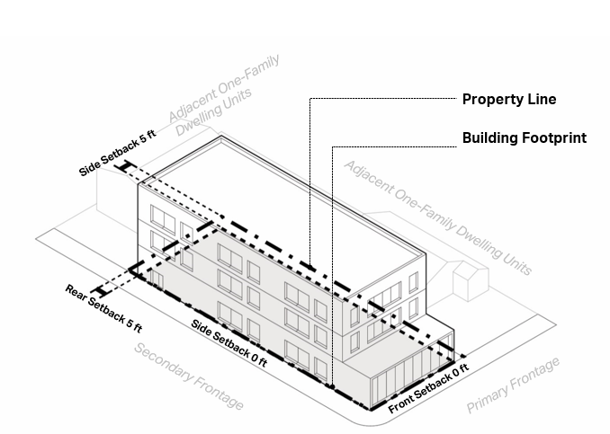
Conditional Use Permit v Site Plan Cont.
Site Plan & Design Reviews
  Assesses the physical characteristics of a development:
    Building location/orientation/height
    Parking
    Access Points
    Lighting
    Landscaping
    Fences/walls
    Ancillary/accessory structures
    Public infrastructure improvements

Slide 11
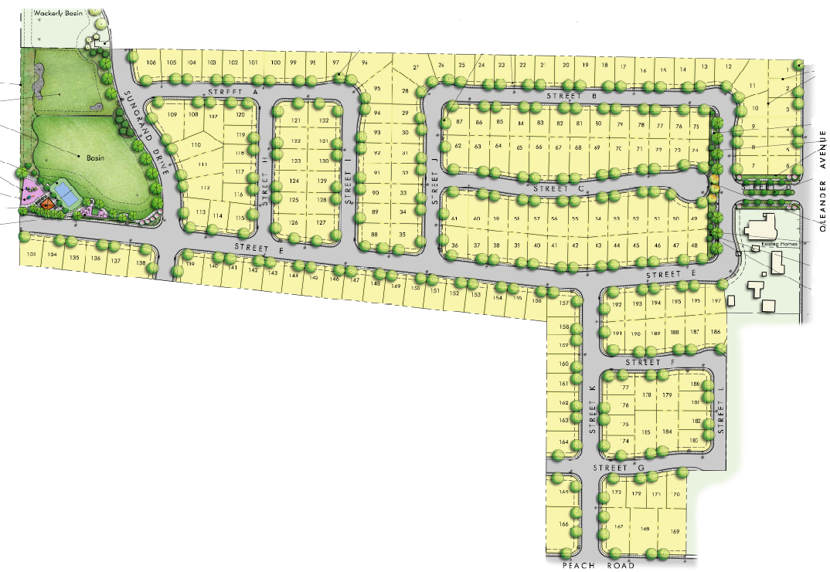
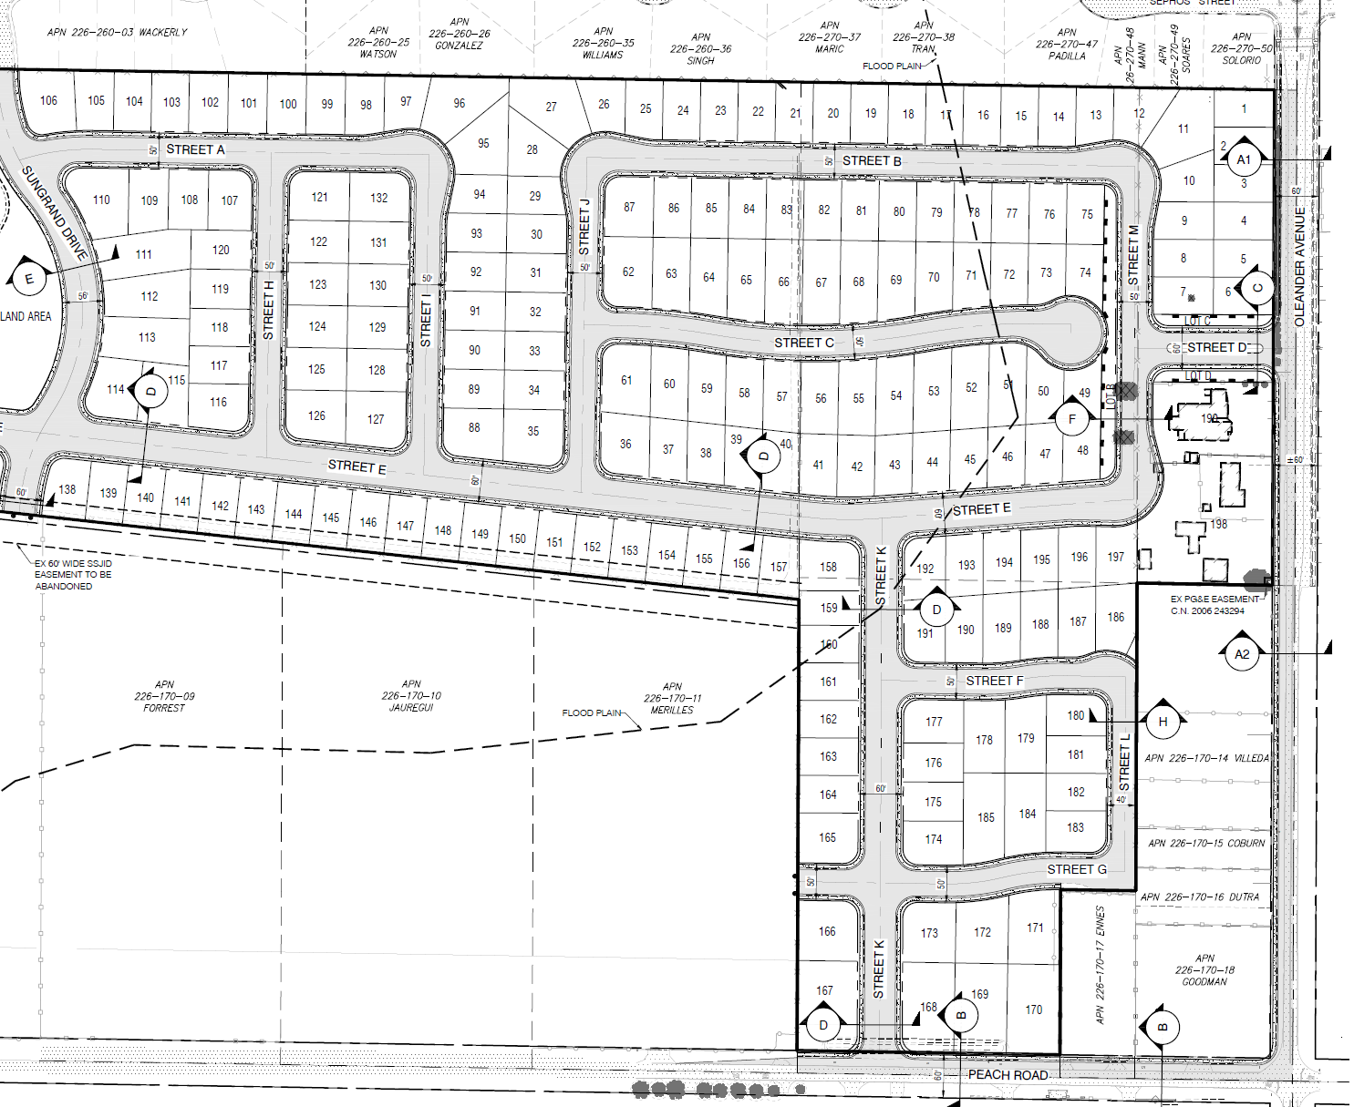
Land Division
Lot Line Adjustments / Lot Mergers
Tentative Parcel Maps
Urban Lot Splits / SB 9
Tentative Parcel Maps ( ≤ 4 parcels)
Tentative Subdivision Maps (5 ≥ parcels)

Slide 12

California Environmental Quality Act (CEQA)
Exemptions
Statutory Exemptions
Categorical Exemptions
Other; “General Plan Consistency”
Negative Declarations
Initial Studies
Public Review & Comment
Adoption by PC/CC
Environmental Impact Reports
Notice of Preparation
Public Review and Comments
Certification by PC/CC
Initial Studies
Scoping Meeting

Slide 13

Commission’s Principal Role & Responsibility
Stay within subject matter & jurisdiction
Be objective; be impartial
Be respectful towards Commission peers, staff, members of the public, Applicant’s/Developers
Review and consider all staff report information and supporting documents
Ask questions of staff
Consider all public testimony & Applicant/Developer testimony
Determine whether the necessary findings to approve; approve with conditions; or deny a project have/or can be made.

Slide 14

Questions

